Slide 1
UAT #2 – Result summary

Slide 2
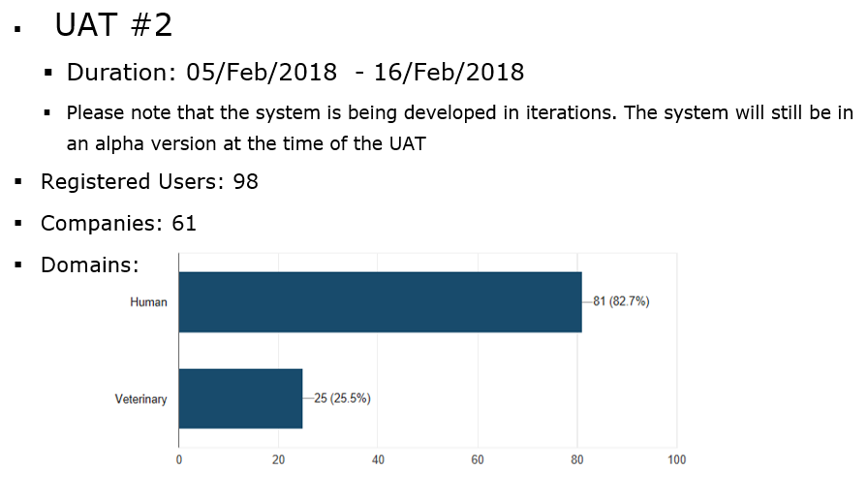

Slide 3
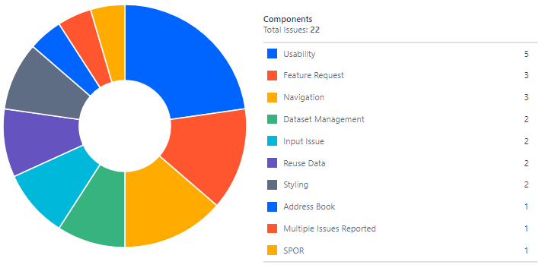
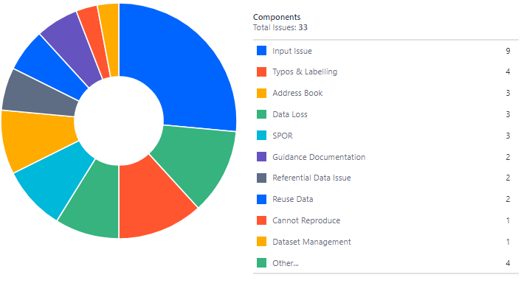
CESSP UAT# 1 – System Features
Report Summary UAT 2
Areas of Improvement
Areas Where Bugs were Reported

Slide 4
CESSP UAT# 1 – System Features
Next Steps
Data Validation
Import & Export
Audit Trail

